Slide 1
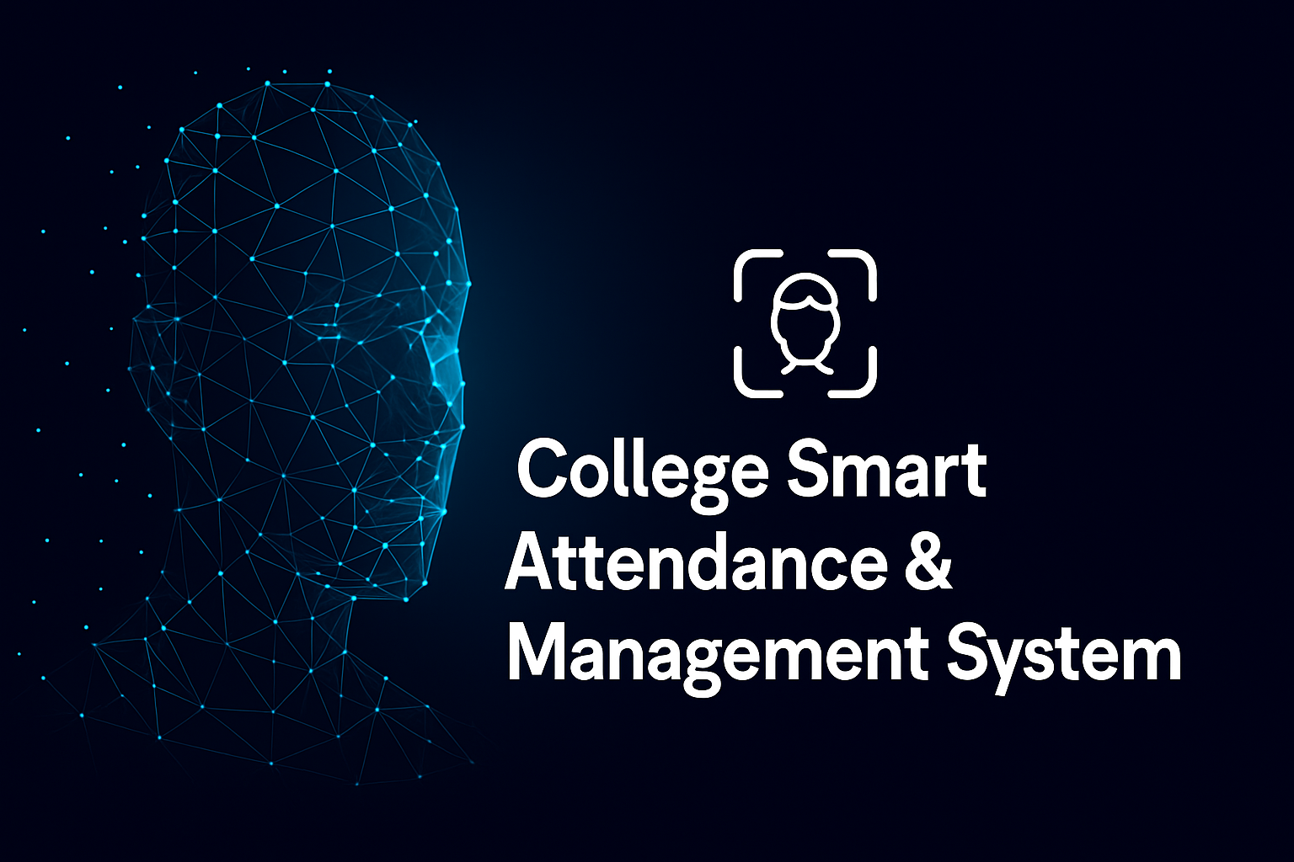

Slide 2


Team Members
Mohamed Amr Ahmed Madkour
Mohamed Salah El-Din Abdel-Qader
Mohamed Abdel-Baky El-Sayed Bakry
Omar Mohamed El-Sayed El-Tony
Mariam Ahmed Abdel El-Hady Salman
Weam Osama Mohamed Kassem
Prof Dr. Sahar Kamal Academic Supervisor
T.A .Amira El-Sayed Assisting Supervisor

Slide 3
TABLE OF CONTENTS
01
02
03
04
05
06
INTRODUCTION
problem Statement
Face Detection
Face recognition
USER INTERFACE DEVELOPMENT
BACK-END IMPLEMENTATION

Slide 4
01
INTRODUCTION

Slide 5

INTRODUCTION
In many educational institutions, traditional attendance methods like manual sign-ins or paper sheets are still used
These methods are time-consuming, inaccurate, and vulnerable to proxy attendance.
Our project introduces a smart attendance system powered by AI and face recognition technology

Slide 6
02
Problem Statement

Slide 7
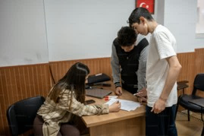
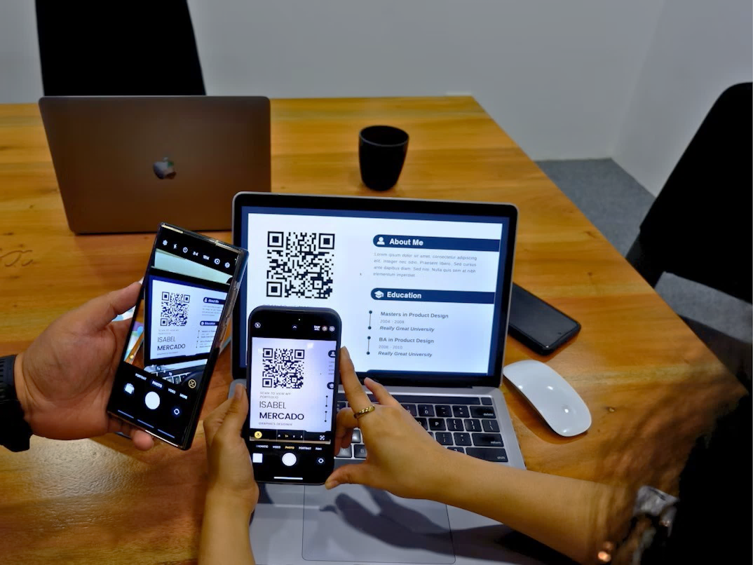
Problem Statement
Manual attendance methods are:
Time-consuming
Error-prone
Easy to manipulate (proxy attendance)
Modern systems (RFID, QR, fingerprint) :
Not ideal for large academic environments
Require physical contact
Expensive to implement

Slide 8



Problem Statement
These challenges highlight the need for smart, automated attendance systems built for today’s academic needs.
Manual attendance methods are:
Time-consuming
Error-prone
Easy to manipulate (proxy attendance)
Modern systems (RFID, QR, fingerprint) :
Require physical contact
Expensive to implement
Not ideal for large academic environments

Slide 9
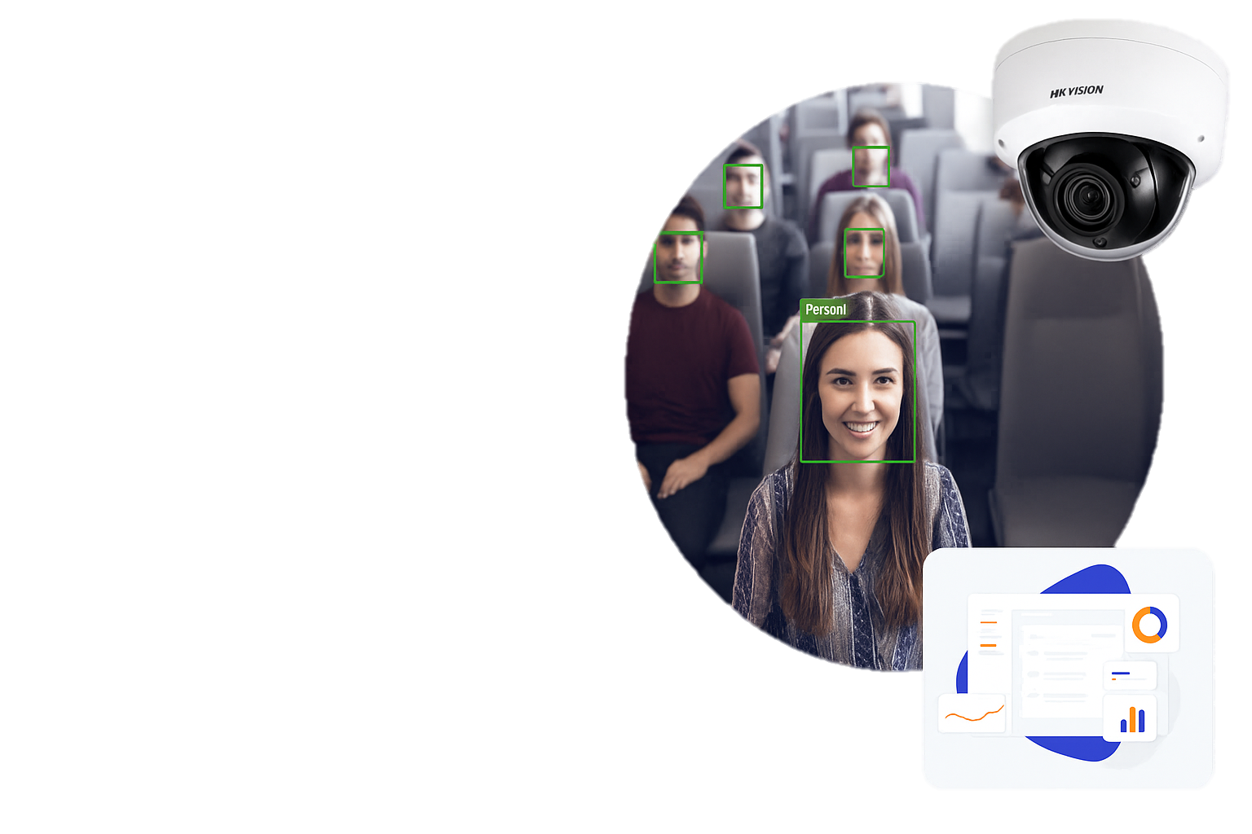

Proposed Solution
• Developed an AI-powered system that recognizes students’ faces for automatic attendance.
• Eliminates the need for ID cards or physical check-ins.
• Students are detected in real-time as they enter the classroom.
• Uses a live camera feed + deep learning models (YOLOv11n + Face Net).

Slide 10
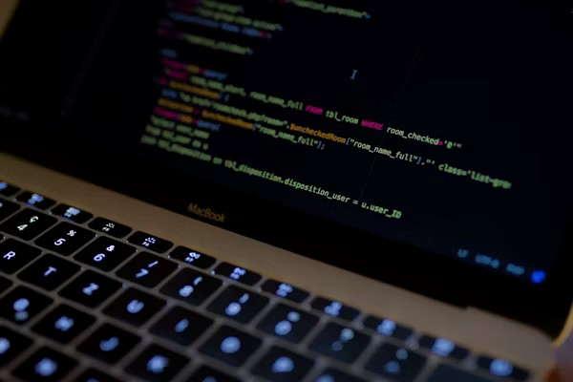

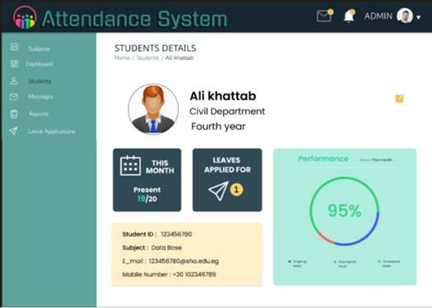
How We’re Building the System
Train an AI model for Face Detection & Recognition
Deploy a Database System for records storage and data integrity assurance
Develop a user interface to be able to interact with the system

Slide 11


System Architecture
Web & Mobile Interface
AI Model
YOLO11N
FACE Net
backend
Face detection & Recognition
DATABASE

Slide 12
TABLE OF CONTENTS
01
02
03
04
05
06
INTRODUCTION
problem Statement
Face Detection
Face recognition
USER INTERFACE DEVELOPMENT
BACK-END IMPLEMENTATION

Slide 13
03
Face Detection
Using YOLOv11n

Slide 14
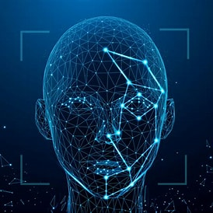
Face Detection
overview
Face detection is a fundamental stage in facial recognition systems.
It enables the system to identify and locate human faces within digital images or video streams.
This is achieved by analyzing distinct facial features such as the eyes, nose, and mouth.

Slide 15


Face detection algorithm(YOLO)
YOLOv11n, our chosen detection algorithm.
It’s the last version of yolo algorithm
Why YOLOv11n?
Real-time detection with minimal latency.
High accuracy powered by deep learning.
Versatile use across mobile, security, and social platforms

Slide 16
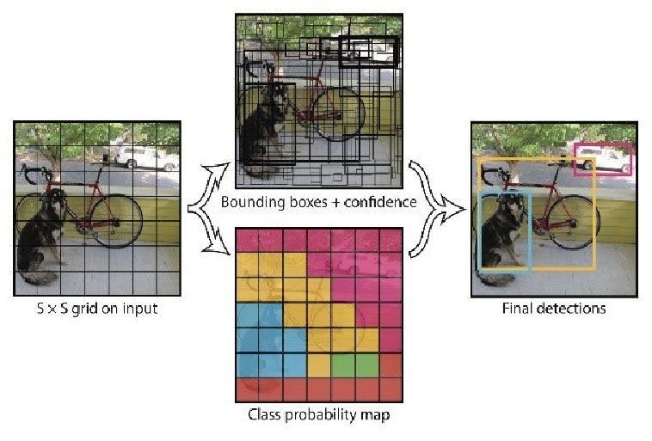
How YOLO works
It works by dividing the input image into grids and detecting face locations.
Trained on a diverse facial dataset for better accuracy

Slide 17
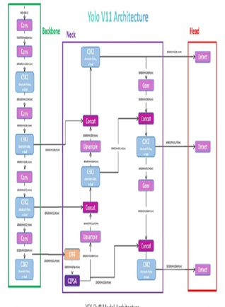
Implemented face detection using YOLOv11.
Model architecture included:
Neck (SPPF):
Strengthens feature learning.
Backbone (C3K2): Extracts core image features.
C2PSA (Head): Responsible for predictions.

Slide 18
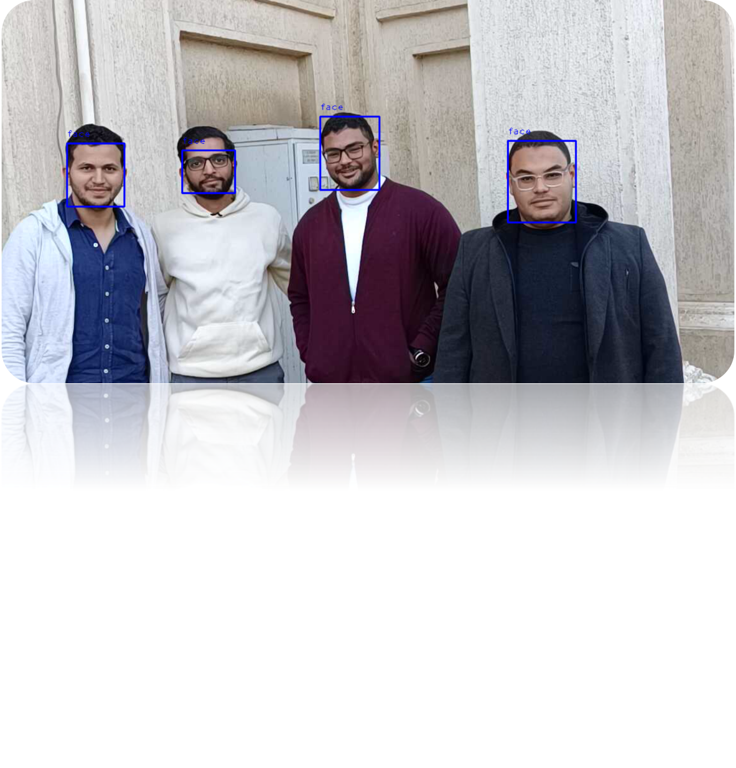
RESULT
Initial training showed promising results but needed improvement

Slide 19
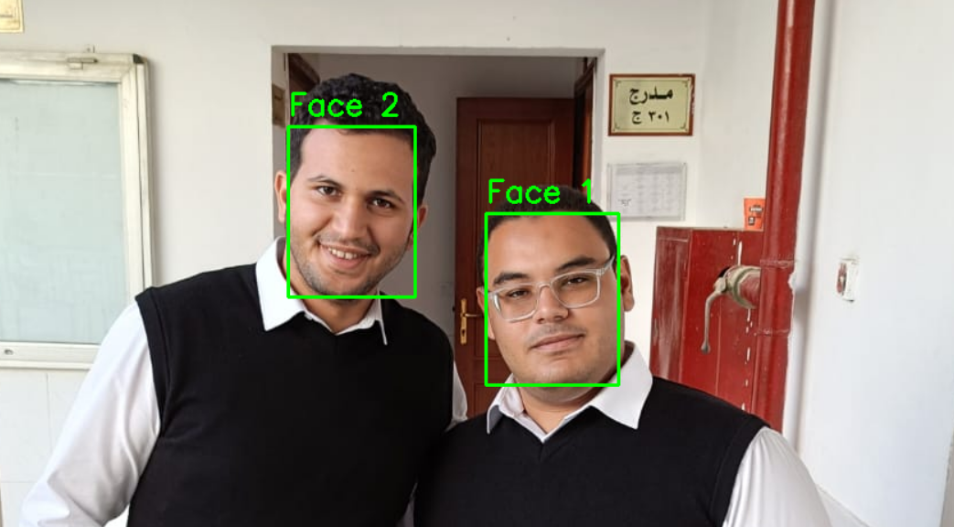
Face Detection Test
Retrained on a larger dataset.
Significantly reduced false. Detections
Detection is now more stable and ready for the face recognition phase.

Slide 20
Face Detection Accuracy under Varying Conditions
Accuracy results across different scenarios:
• Easy = Frontal faces, good lighting
• Medium = Side angles, medium lighting
• Hard = Low light or partially occluded faces
EASY
MEDIUM
HARD

Slide 21
TABLE OF CONTENTS
01
02
03
04
05
06
INTRODUCTION
PROBLEM & SOLUTION
Face Detection
Face Recognition
BACK-END IMPLEMENTATION
USER INTERFACE DEVELOPMENT

Slide 22
04
Face Recognition
Using FaceNet With InceptionResNetV1

Slide 23
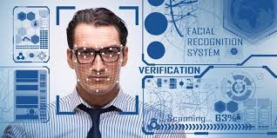
Face Recognition
overview
Face recognition is a sophisticated biometric technology that employs computer vision and machine learning algorithms to identify or verify an individual's identity by analyzing unique patterns and characteristics derived from their facial features.

Slide 24
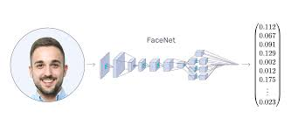
FaceNet Algorithm
FaceNet is a deep learning model developed by Google researchers in 2015 to directly learn a mapping from face images to a compact Euclidean space. In this space, distances directly correspond to a measure of face similarity

Slide 25
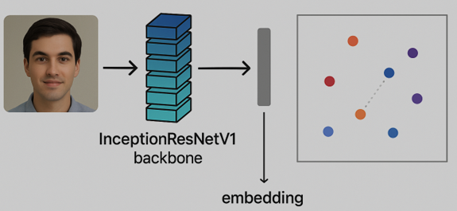
InceptionResNetV1 Architecture
InceptionResNetV1 is a deep convolutional neural network and the backbone of Face Net that combines two powerful ideas in computer vision: 1. the Inception architecture, which captures features at multiple scales.
2. Residual connections, which allow deeper and more stable training.
This combination allows the model to extract deep and reliable features from facial images with high accuracy.

Slide 26
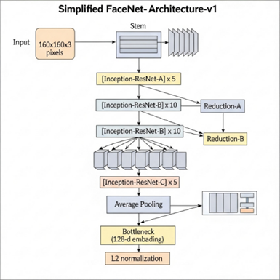
FaceNet with Architecture InceptionResNetV1
Average Pooling: Averages each feature map into a single value
Stem
It performs basic feature extraction and reduces spatial dimensions
Bottleneck (128-d Embedding): A fully connected layer turns the pooled features into a face embedding.
Inception Blocks:
Capture multi-scale features by applying 1x1, 3x3, and 5x5 convolutions in parallel to extract complex features.
L2 Normalization: Ensures embeddings lie on a unit hypersphere for consistent distance comparisons.

Slide 27
Recognition Pipeline
1
Collecting dataset
2
Face detection
3
Image processing
4
Face embedding
5
Face recognition
6
Test AI Model

Slide 28
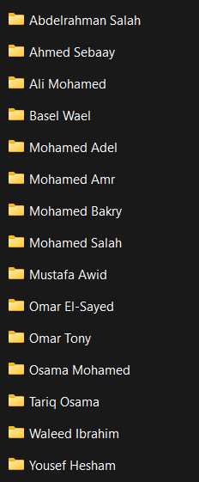
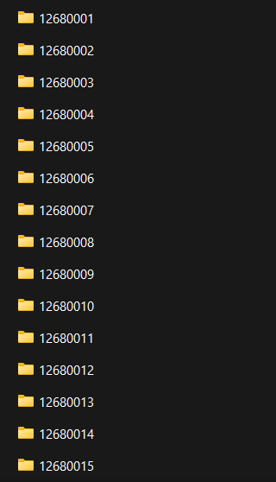
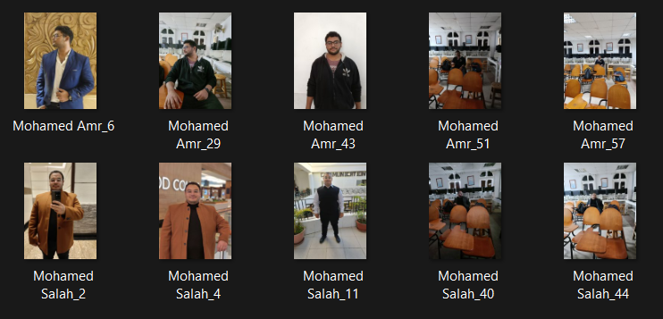
Recognition Pipeline
Collect about 20-30 images for each student
6
Test the system
1
Collecting dataset
2
Face detection
3
Image processing
5
Face recognition
4
Face embedding

Slide 29
Recognition Pipeline
Detect Faces using YOLOv11n from video stream or image
6
Test the system
4
Face embedding
2
Face detection
1
Collecting dataset
5
Face recognition
3
Image processing

Slide 30
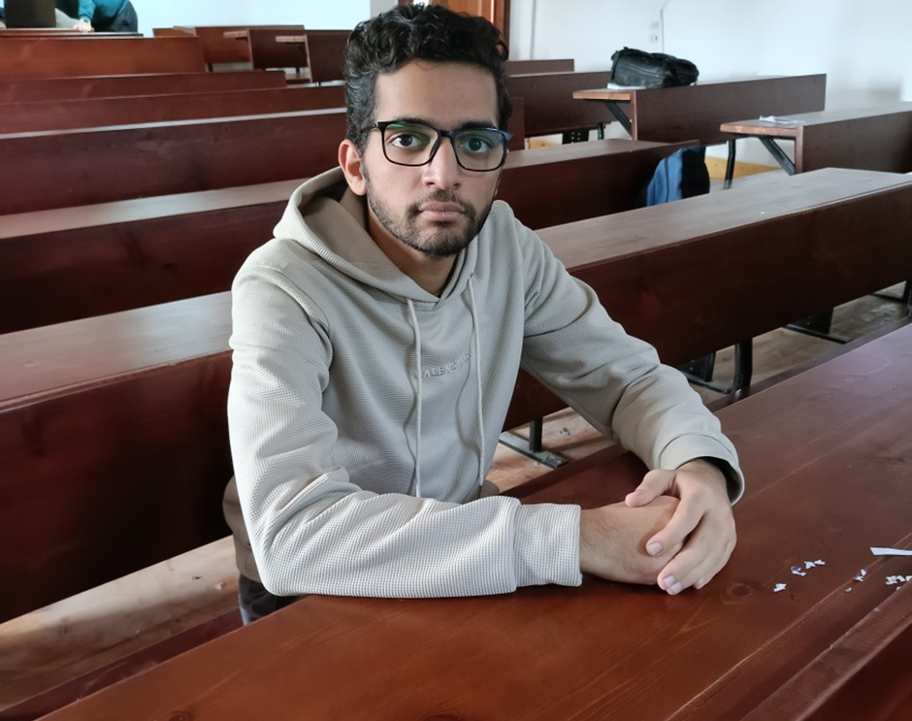
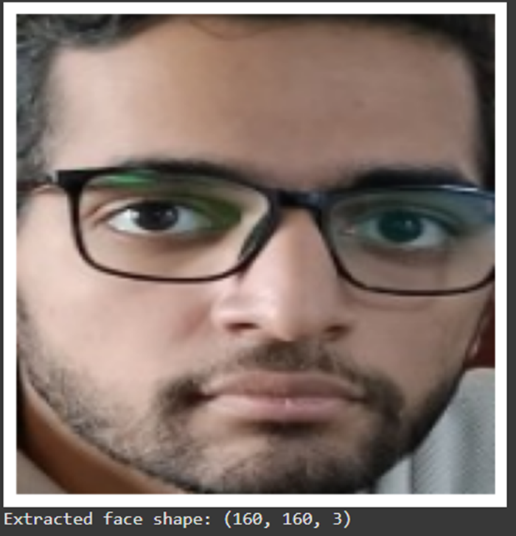
Recognition Pipeline
4
Face embedding
FaceNet expects all faces to be:
Aligned
Resized to (160×160) pixels
Normalized
1
Collecting dataset
3
Image processing
2
Face detection
6
Test the system
5
Face recognition

Slide 31
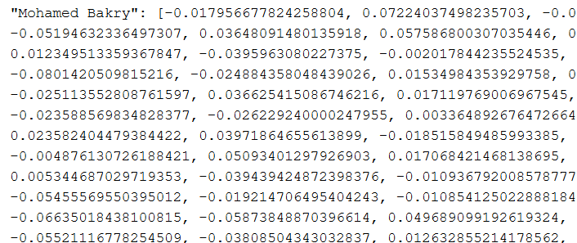
Recognition Pipeline
2
Face detection
We use FaceNet to convert each detected and preprocessed face into a 128-dimensional embedding vector.
These embeddings capture unique facial features and are used for identity comparison using Euclidean distance.
4
Face embedding
1
Collecting dataset
5
Face recognition
3
Image processing
6
Test the system

Slide 32
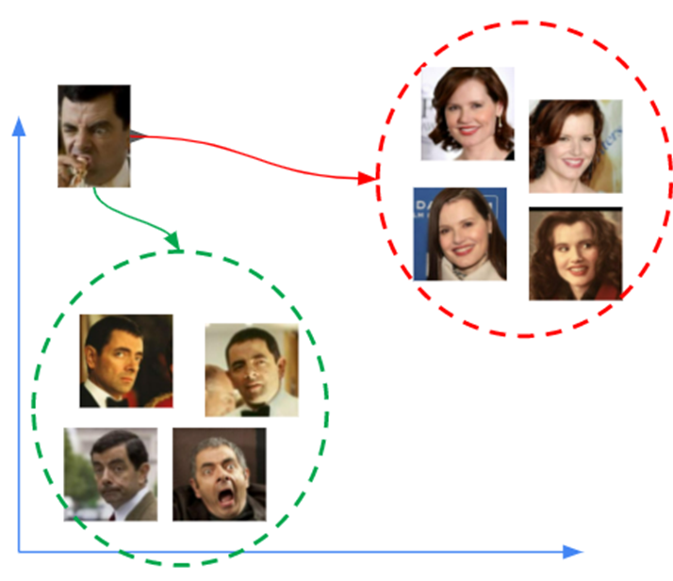
Recognition Pipeline
2
Face detection
6
Test the system
Distance threshold :
Compare live embedding to all stored embeddings
Use Euclidean distance
If distance < threshold, it is a match
1
Collecting dataset
5
Face recognition
3
Image processing
4
Face embedding

Slide 33
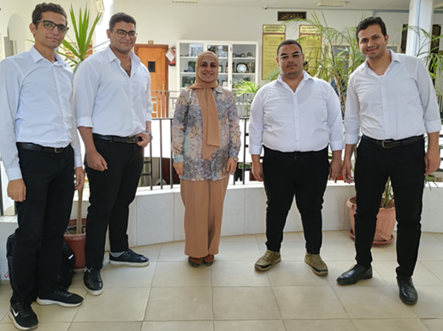
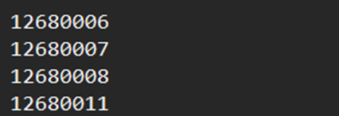
Recognition Pipeline
4
Face embedding
2
Face detection
6
Test AI Model
3
Image processing
1
Collecting dataset
5
Face recognition
INPUT
Output
(students’ IDs)

Slide 34
Limitations
LIGHT
Performance may vary in extreme lighting conditions

Slide 35
Limitations
LIGHT
FACE ANGLE
Performance may vary in extreme lighting conditions
Best suited for frontal and slightly angled faces

Slide 36
Limitations
LIGHT
FACE ANGLE
Performance may vary in extreme lighting conditions
Best suited for frontal and slightly angled faces
RESOLUTION
Camera resolution may affect recognition performance

Slide 37
TABLE OF CONTENTS
01
02
03
04
05
06
INTRODUCTION
problem Statement
Face Detection
Face recognition
USER INTERFACE DEVELOPMENT
BACK-END IMPLEMENTATION

Slide 38
05
USER INTERFACE DEVELOPMENT
Mobile and Web interface

Slide 39
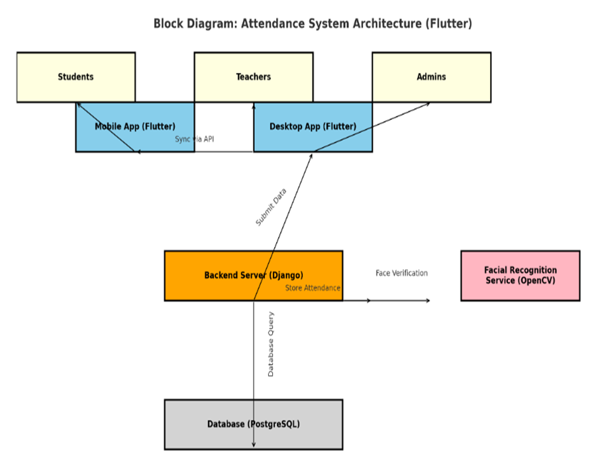
Application System
Defined system roles and structure.
Designed system architecture connecting Mobile App, Web Dashboard, API, AI Model, and Database.
Prepared environment for development.
Context Diagram

Slide 40
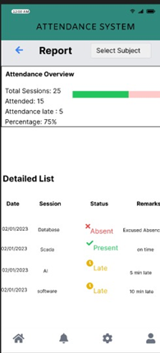
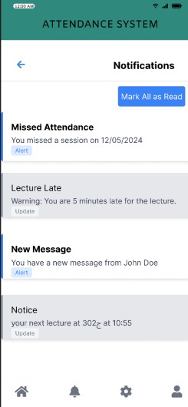
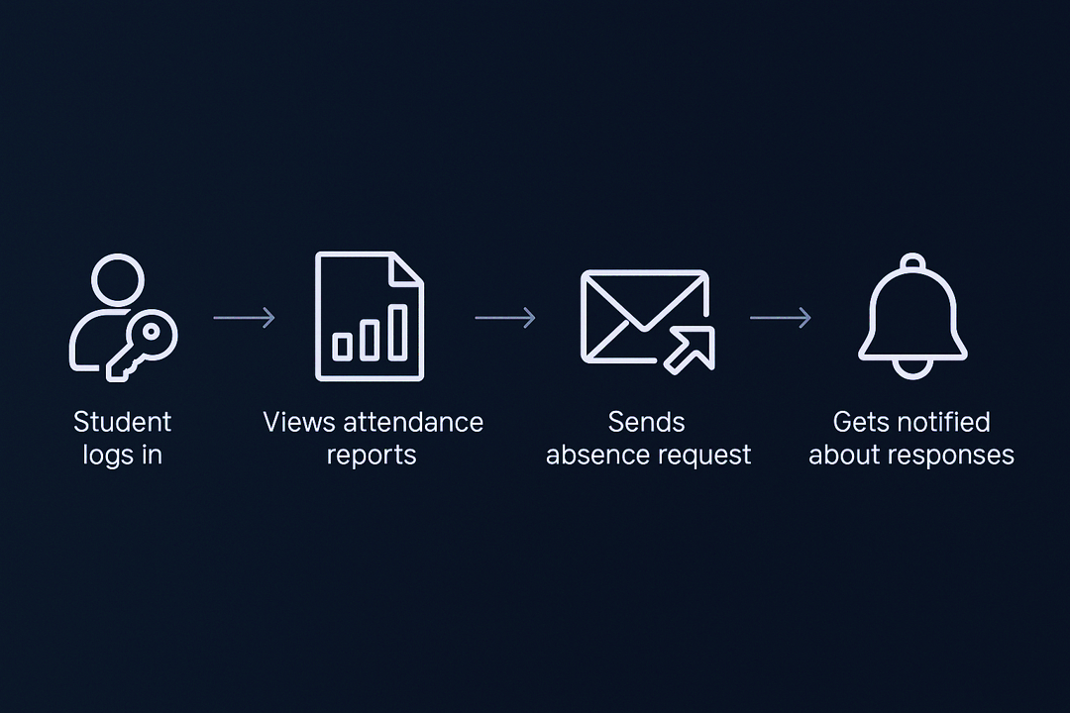
Mobile Application-Business Process

Slide 41
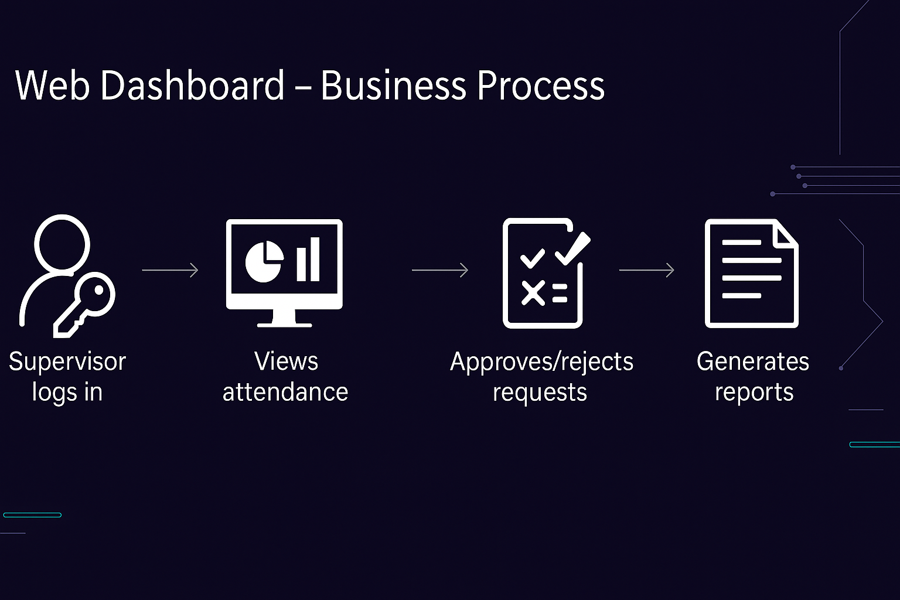
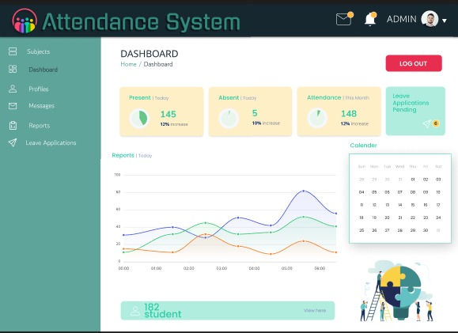
Web Dashboard – Business Process
Web Dashboard – Business Flow

Slide 42
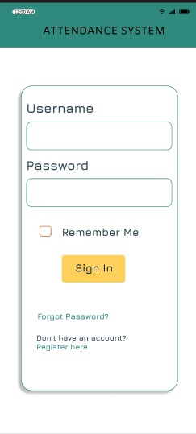
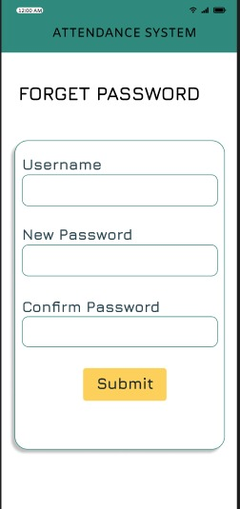
Mobile App – Functional Requirements
Login
Registration
Attendance Records
Reports
Absence Request
Notifications
Settings & Profile

Slide 43
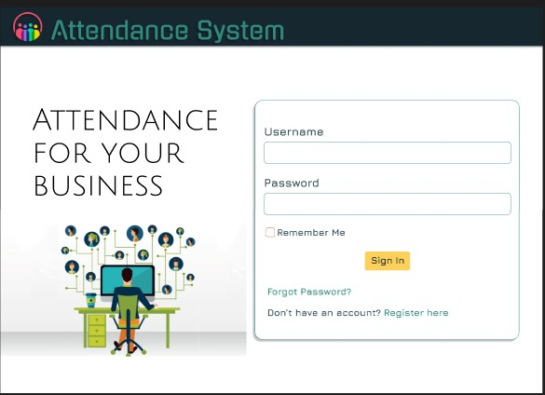
Web Dashboard –Requirements
1- Functional Requirement :
Login Page
Forgot Password Page
Dashboard Page
Profile Page
Student Details Page
Subjects Page
Monthly Reports
Messages
Exit Application

Slide 44
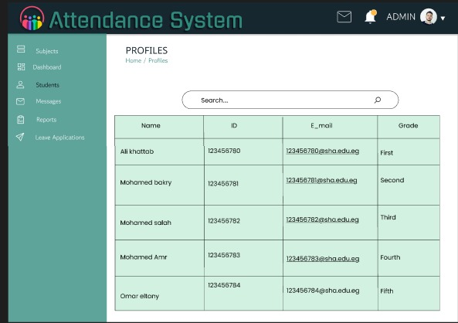
Web Dashboard –Requirements
2- Non-Functional Requirement :
Usability
Availability
Maintainability
Performance

Slide 45
Business Rules
These rules are represented and explained using:
Mobile Application
Activity Diagram
Use Case Diagram
Web Dashboard
Activity Diagram
Use Case Diagram

Slide 46



Technology Used
flutter
HTML+DIJANGO

Slide 47

Flutter for All Platforms
Flutter is Google’s open-source framework to build apps for mobile, web, and desktop using one codebase.
Why We Used Flutter?
One Code for All – mobile, web, desktop
Beautiful & Easy UI
Fast Performance
Hot Reload = Instant Changes
Big Community & Tools

Slide 48

Implementation Web Dashboard
We used Django, a Python web framework, to handle backend logic and routing. And we used HTML to build the frontend pages the user interacts with.
HTML Templates: Dashboard, Absence Requests, Reports, Profile
Django Views: Each page connected to a function in views.py
URL Routing: Used path() and name in urls.py
Role-Based Access: Features restricted to instructors

Slide 49
Figma Design

Slide 50
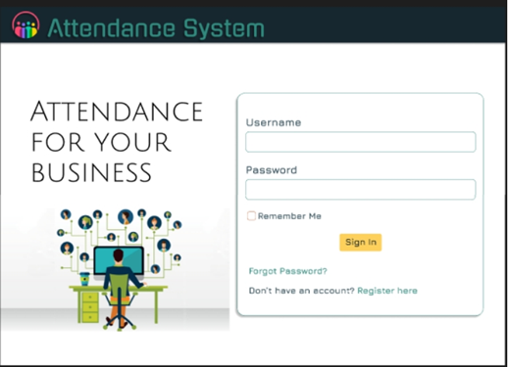
Web Application (Admin/Instructor Role)
Login page

Slide 51
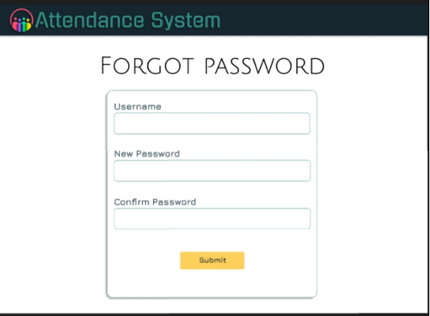
Web Application (Admin/Instructor Role)
Forget Password

Slide 52
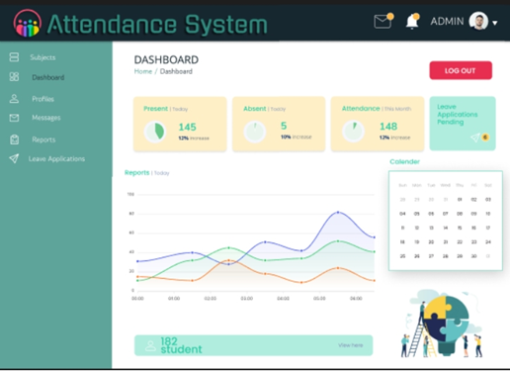
Web Application (Admin/Instructor Role)
Dashboard Page

Slide 53
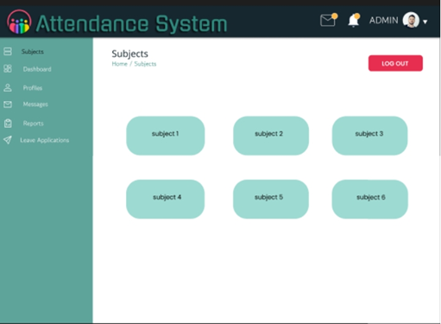
Web Application (Admin/Instructor Role)
Subject Page

Slide 54

Web Application (Admin/Instructor Role)
Profiles Page

Slide 55
Web Application (Admin/Instructor Role)
Students Details Page

Slide 56
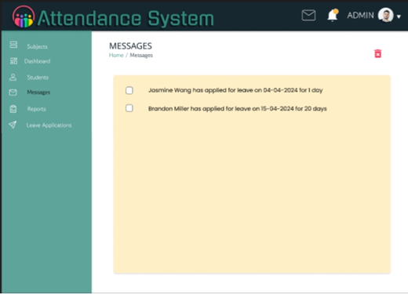
Web Application (Admin/Instructor Role)
Message Page

Slide 57
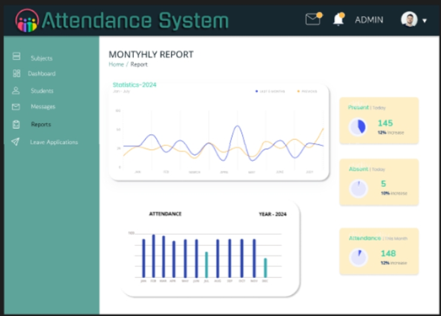
Web Application (Admin/Instructor Role)
Reports Page

Slide 58
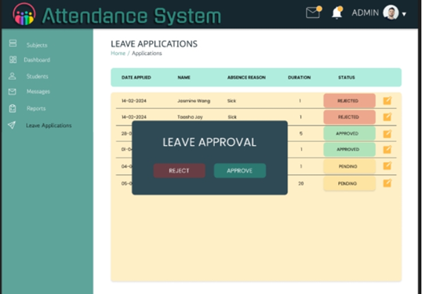
Web Application (Admin/Instructor Role)
Leave Application Page

Slide 59
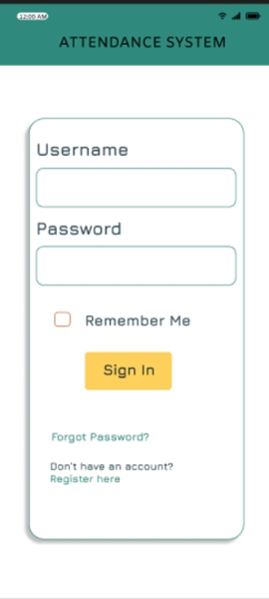
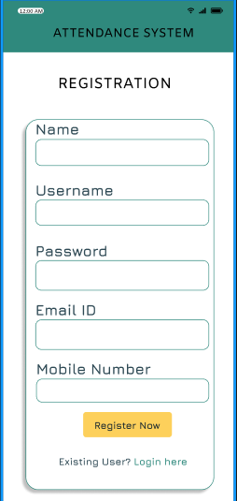
Mobile Application (Student Role)
Login Page
Registration Page

Slide 60

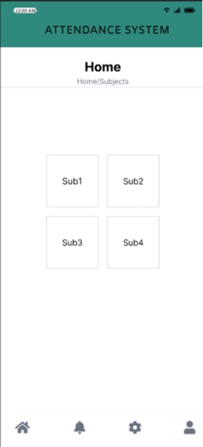
Mobile Application (Student Role)
Home Page
Forget Password
Page

Slide 61
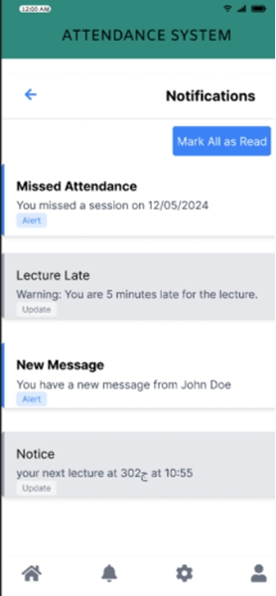
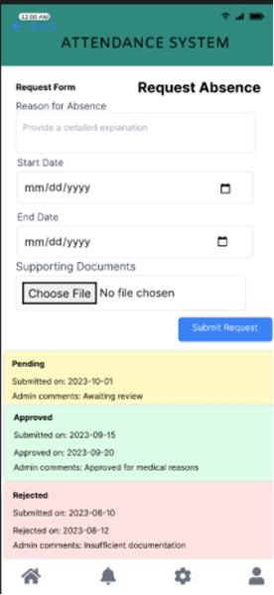
Mobile Application (Student Role)
Notification Page
Request absence Page

Slide 62
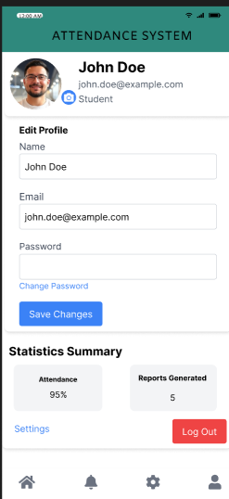
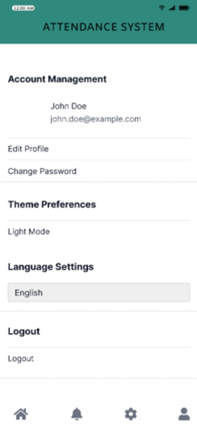
Mobile Application (Student Role)
Profile Page
Settings Page

Slide 63
TABLE OF CONTENTS
01
02
03
04
05
06
INTRODUCTION
problem Statement
Face Detection
Face recognition
USER INTERFACE DEVELOPMENT
BACK-END IMPLEMENTATION

Slide 64
06
BACK-END IMPLEMENTATION

Slide 65


Backend Overview
Backend Responsibilities:
• Manages all system logic and data processing.
• Interfaces with AI module for face recognition.
• Handles user roles and permissions securely.
• Maintains academic data and session records.
• Offers RESTful APIs for frontend/mobile access.

Slide 66


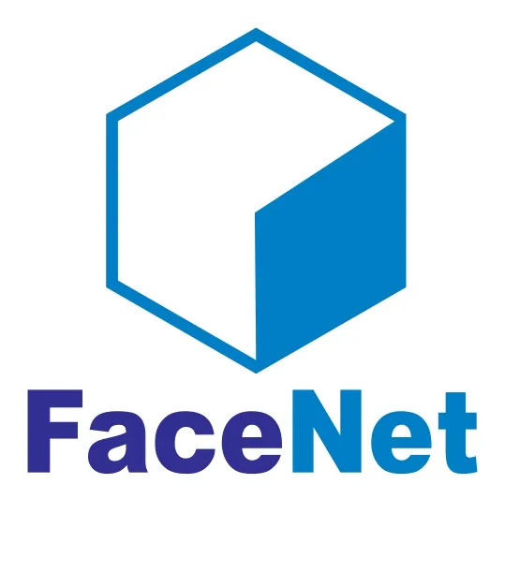


Technology Used
Name | Use | Logo
Django | Web backend framework
Django REST | API handling layer
PostgreSQL | Relational database
Face Net + YOLOv11 | Face detection & recognition
JWT | Authentication and security

Slide 67
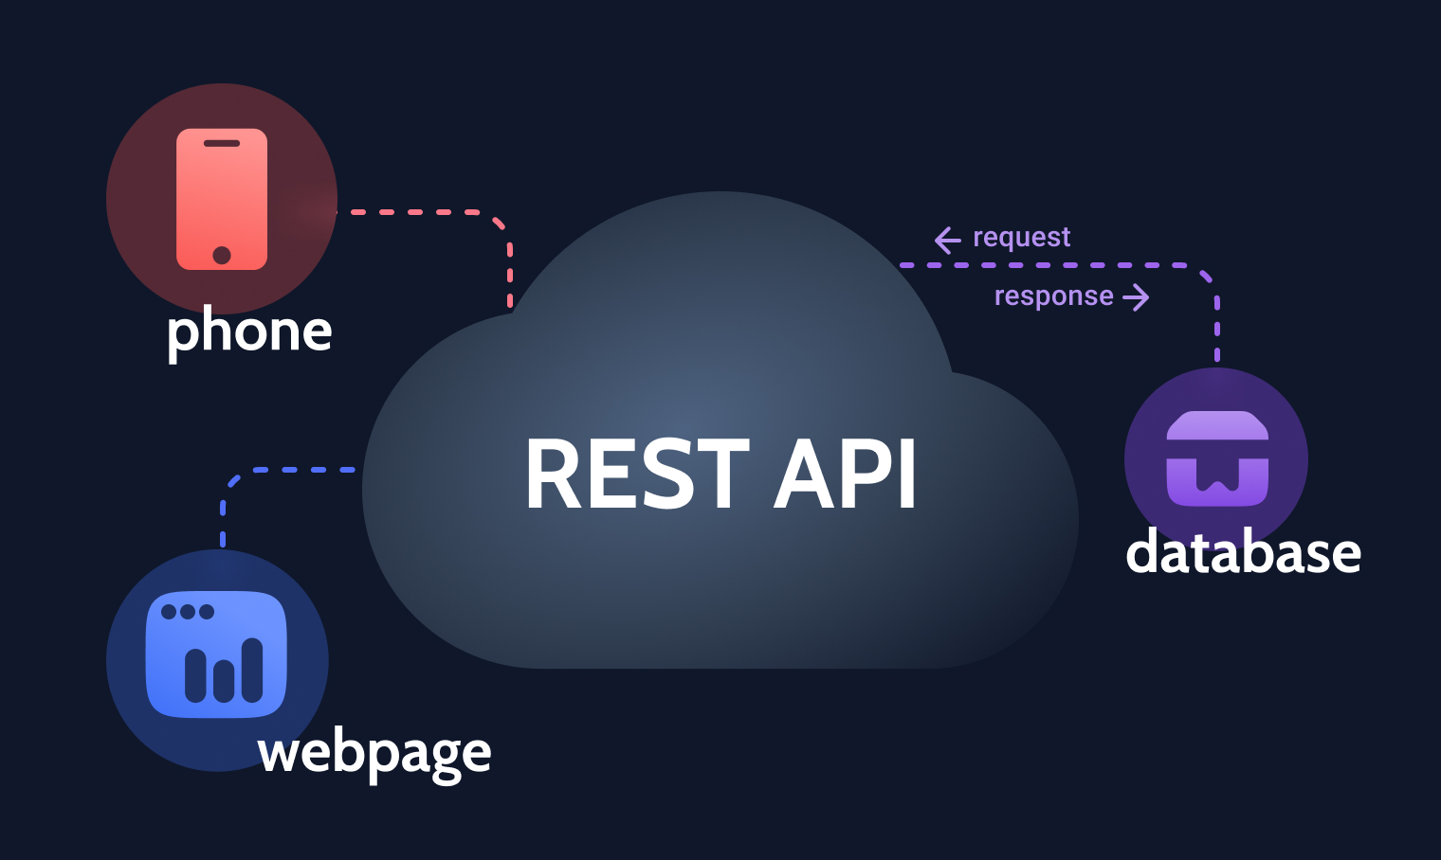
REST API Features
Secure login with JWT
Attendance via camera/image
Leave request system
Endpoints per user type
Stateless, JSON-based communication

Slide 68

Backend Security
• JWT authentication for all users.
• Role-based access control.
• Input validation through serializers.
• Logging and exception handling.
• Deployment with secure configuration

Slide 69

Final Notes & Scalability
• Modular architecture – each function in a separate app.
• Scalable deployment using Docker/cloud services.
• Logs and monitors backend behavior.
• Ready for multi-campus or multi-classroom expansion

Slide 70
System Workflow
Camera Activation and Frame Capture
Face Recognition using FaceNet Embedding
Session Matching (Date, Time & Subject Validation)
Display Change to Instructor and Student
Attendance Recording in the Database

Slide 71


Camera Activation and Frame Capture
capture

Slide 72

Face Recognition using FaceNet Embedding

Slide 73

Session Matching (Date, Time & Subject Validation)

Slide 74


Attendance Recording in the Database

Slide 75


Display Change to Instructor and Student

Slide 76
Conclusion
Our project showcases how Artificial Intelligence and deep learning models can truly transform attendance tracking in schools and universities. By incorporating real-time face detection and recognition with YOLOv11n and Face Net, we’ve developed a system that is:
- Accurate
- Fast
- Secure
- User-friendly
This innovative solution removes the need for manual processes, boosts reliability, and is designed to scale effectively in larger settings. We’re excited about the potential for this system to be expanded and implemented across various academic and corporate environments in the near future

Slide 77
THANK YOU!
Any questions ?

